Slide 1
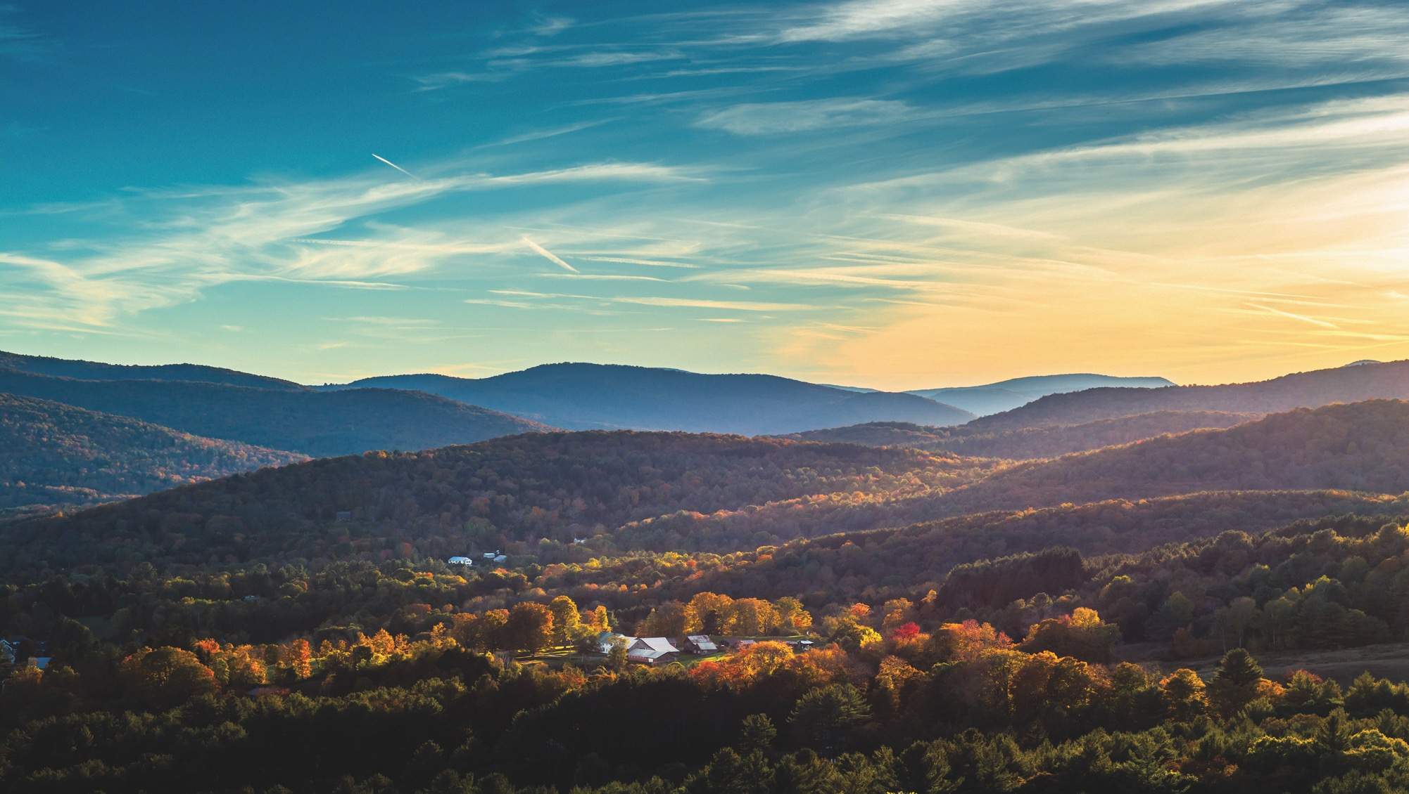

Captive insurance
A possible tool for our company to mitigate our unique insurance challenges
Your company logo here

Slide 2
Agenda
What is captive insurance?
Captive vs. commercial insurance
Why create a captive?
Choosing a strong captive domicile
Vermont’s approach & success
VCIA: Who are they?
Formation steps
Questions

Slide 3

What is a captive?
A ‘captive insurer’ is an insurance company fully owned and controlled by the entities it insures. Its primary purpose is to insure the risk of its owners, who also benefit from any underwriting profits generated by the captive insurer.

Slide 4



A captive insurance company:
Is a licensed insurer that determines premium rates for the specific risks it chooses to underwrite
Collects premiums
and pays for claims made against those policies
Writes the policies for the risks it insures

Slide 5
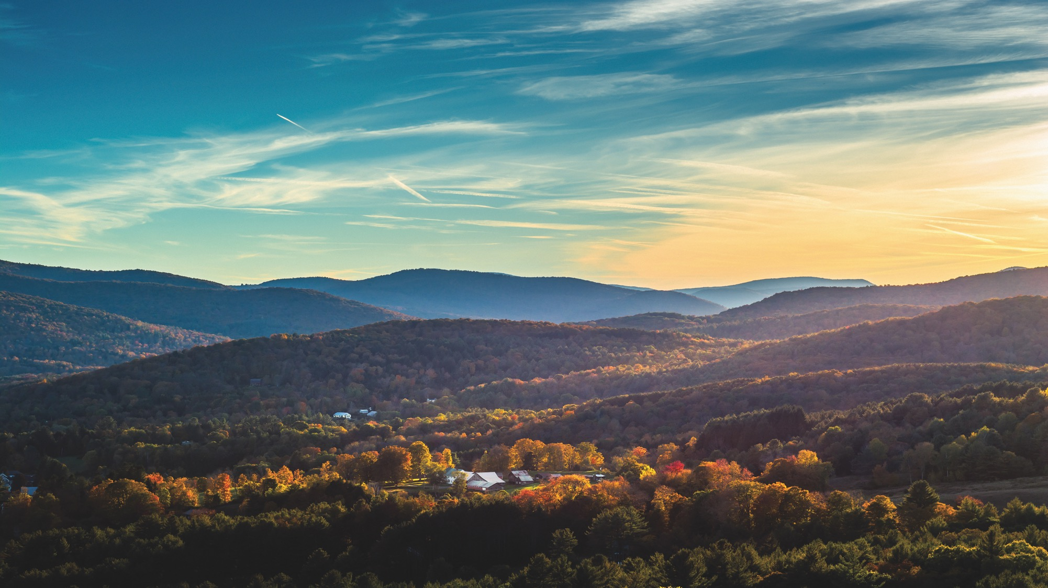
Captive vs. commercial insurance
ASPECT | CAPTIVE | COMMERCIAL
Licensing | Licensed in domicile state only | Licensed in all states where operated
Who they insure | Parent company and affiliates | Public
Regulatory authority | Focused on business plan and solvency | Multi-state regulation of rates, forms, capital
Employees | May or may not have employees (often use service providers) | Yes

Slide 6
Why do organizations set up captives?
Increase control. Reduce costs.
Customized coverage designed to
address your unique risks and fill gaps
in traditional insurance
Reduced operating costs
Improved cash flow
Increased coverage and capacity
Investment income to fund losses
Access to reinsurers (or other forms
of risk transfer)
Funding and underwriting flexibility
Greater control over claims
Smaller deductibles for operating units
Additional negotiating leverage
with underwriters
Incentives for loss control
Brings discipline and attention to risk management and loss prevention

Slide 7
Our unique challenges— why a captive could be ideal
Please fill in this area with information pertinent to your organization.

Slide 8

Choosing a strong captive domicile
Supportive regulatory environment
Political stability
Business infrastructure
Access to expertise
Favorable legal framework
Reasonable capitalization requirements
Investment flexibility
Competitive premium taxes
Active industry associations

Slide 9
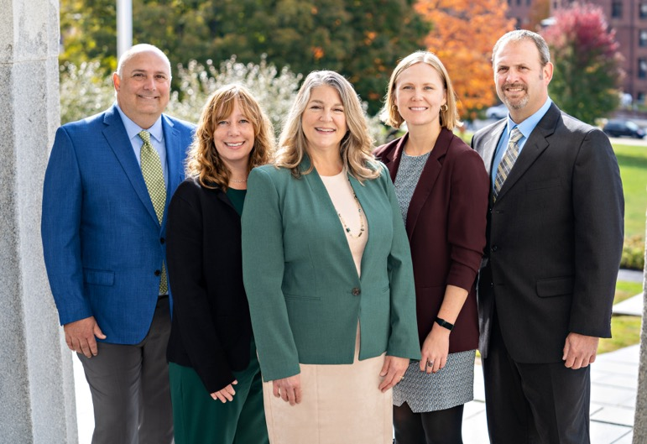
How does Vermont do it?
The three KEY PLAYERS of
Vermont Captive
  Vermont Department of Federal Regulation (DFR) regulates and oversees the financial health, compliance, and stability of captive insurers.
  Vermont Department of Economic Development (DED) drives economic growth and supports captive insurance industry initiatives.
  Vermont Captive Insurance Association (VCIA) advocates for the industry, providing education, networking, and support for captive insurers.

Slide 10

Vermont’s regulatory approach
Application for licensure
Face-to-face meetings
Financial analysis
Plan changes and approvals
Regulatory examinations
Vermont regulators are dedicated to supporting you at every stage—ready to answer questions, consider innovative ideas, or simply check in—both during and long after your captive is formed.

Slide 11
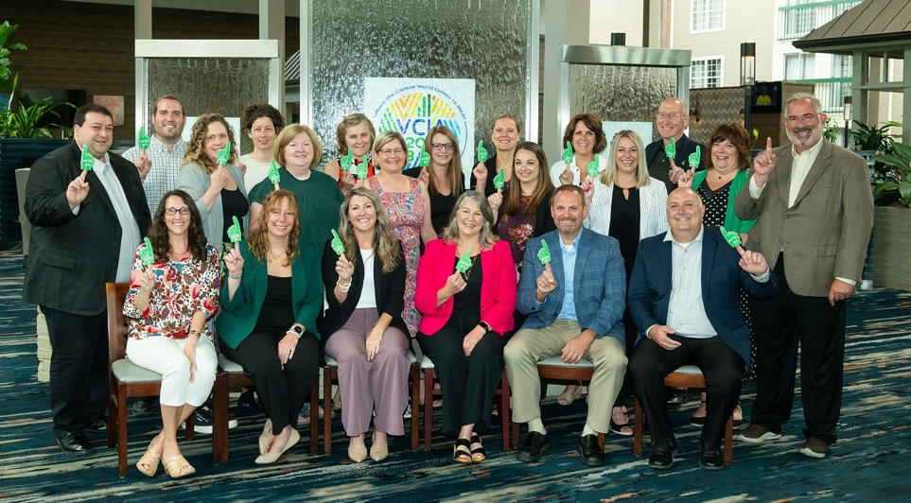
Vermont DFR—Captive Division
Experienced and knowledgeable regulatory team of 32—captive insurance is our only business
Over 300 years of combined regulatory experience​
Over 500 years of combined industry experience
8 Certified Public Accountants​
19 Accredited/Certified Financial Examiners​
Many more specialists with a variety of other designations (financial, insurance, regulatory)

Slide 12
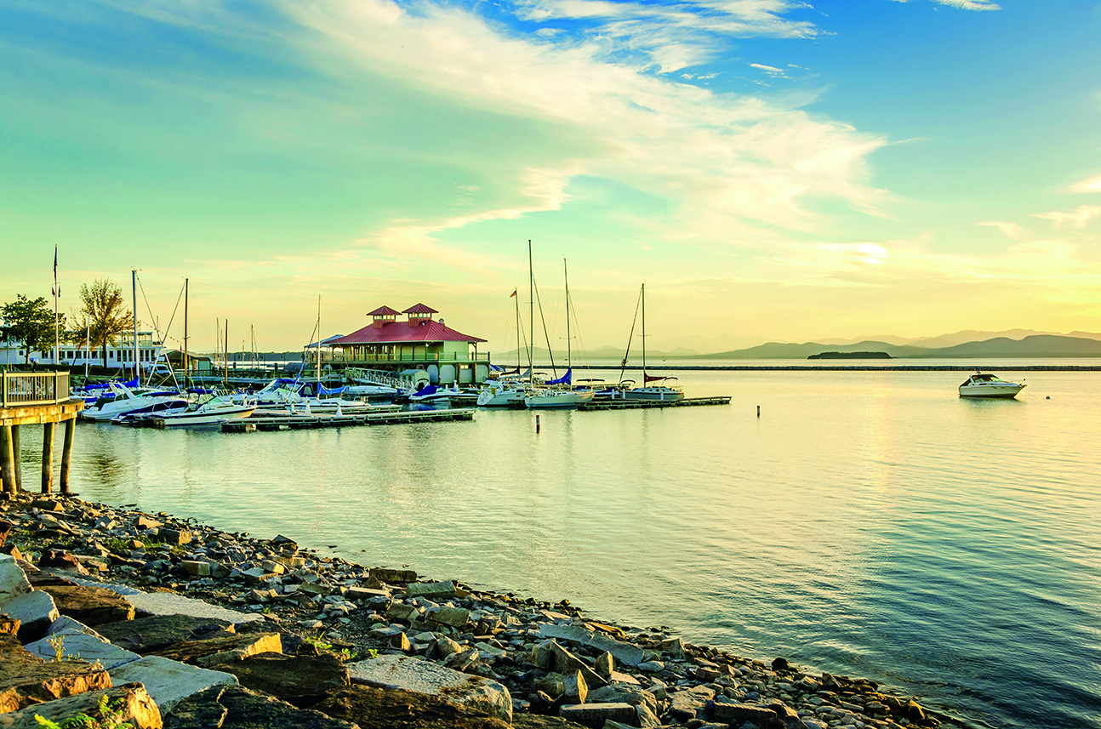
Industries represented in Vermont’s captives
Healthcare
Manufacturing
Insurance
Education
Energy
Entertainment
Financial lending
Agriculture
Hotel & hospitality
Communications
Banking
Media
Municipalities
Nonprofits
Professional service
Real estate
Religious institutions
Retail
Securities
Technology

Slide 13


Vermont—the world’s #1 captive domicile
$33 billion in gross written premiums (2024)
Over 44 years of leadership in captive insurance
1,397 captives licensed*
50% of Fortune 100 companies choose Vermont
50% of Dow Jones 30 are represented
Over 80 international companies licensed,
with ownership spanning 23 countries
*as of 6/30/2025

Slide 14

Vermont Captive Insurance Association
An important resource
The largest captive insurance association in the world
Responsible for promoting and sustaining the general welfare of Vermont as the world’s leading captive domicile
VCIA puts on an annual conference, where industry leaders from around the world meet to learn, network, and innovate in Burlington, Vermont
Only association with a full-time captive insurance lobbyist based in Washington D.C.

Slide 15

Why is Vermont the best choice for you?
Blank slide with information on why Vermont is best for the particular company, how the state suits their unique needs

Slide 16


Steps to form a captive
Select an approved manager
in Vermont
Arrange a meeting through your approved manager with Vermont DFR
Prepare necessary documents for organization and for application to DFR (this step may be easier with a local lawyer)
Submit a copy of all documents to the DFR commissioner for review
Submit an additional copy to the assigned review firm when instructed to
Petition commissioner to issue a Certificate of Public Good
Once certificate is issued, present this, the documents from step 3, and appropriate fees to the VT Secretary of State’s office for captive organization
Apply to the commissioner for Certificate of Authority
Visit dfr.vermont.gov/captive-insurance for more detailed information

Slide 17
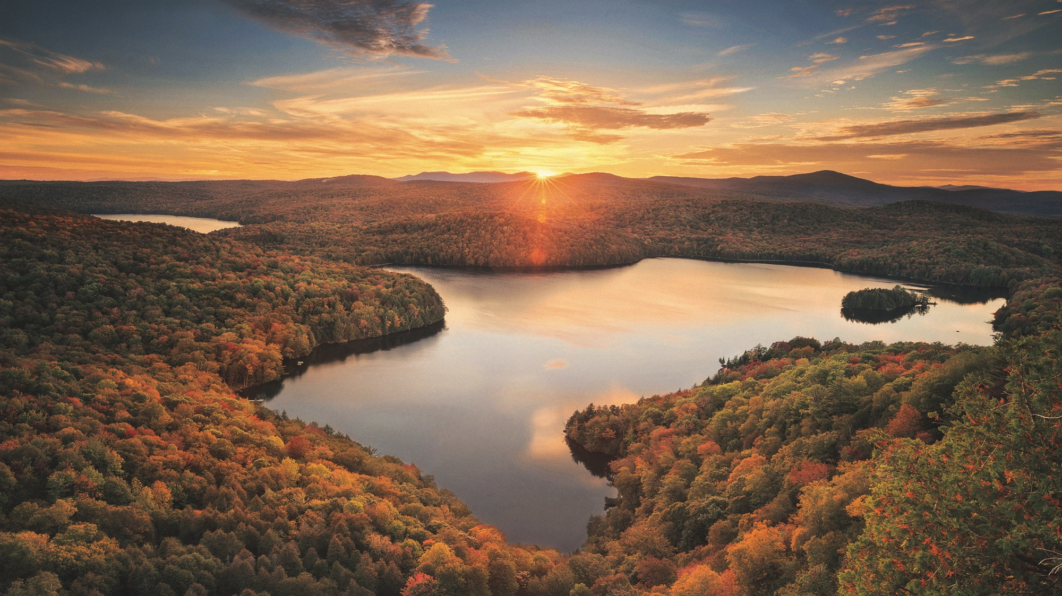
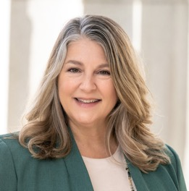
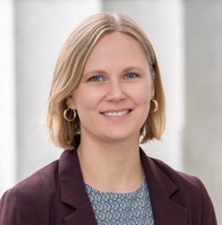
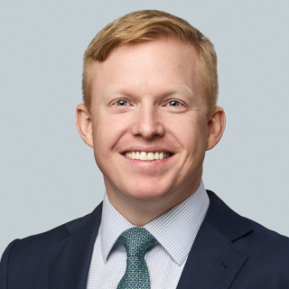
Questions?
Sandy Bigglestone
Deputy Commissioner of
Captive Insurance Division
sandy.bigglestone@vermont.gov​
dfr.vermont.gov/captive-insurance
Brittany Nevins
Captive Insurance Economic
Development Director
brittany.nevins@vermont.gov
vermontcaptive.com
accd.vermont.gov/economic-development
Ian Davis
VCIA President
idavis@vcia.com
vcia.com

